Slide 1
How to Get on the new Microsoft Tenant
It's simple, really

Slide 2
What is a Microsoft 'Tenant'?
A tenant is just a fancy word for a Microsoft license. It comprises all the people in our organization. That's it!
Our Microsoft Tenant is comprised of all the Cadets and Senior Members under a single license. Our license is controlled by Pacific Coast Region, CAP

Slide 3
You're Going to Need Data About Yourself
Your last name
Your CAPID
Your Rank
Your town of residence
The date you originally joined CAP
These are all on eServices

Slide 4
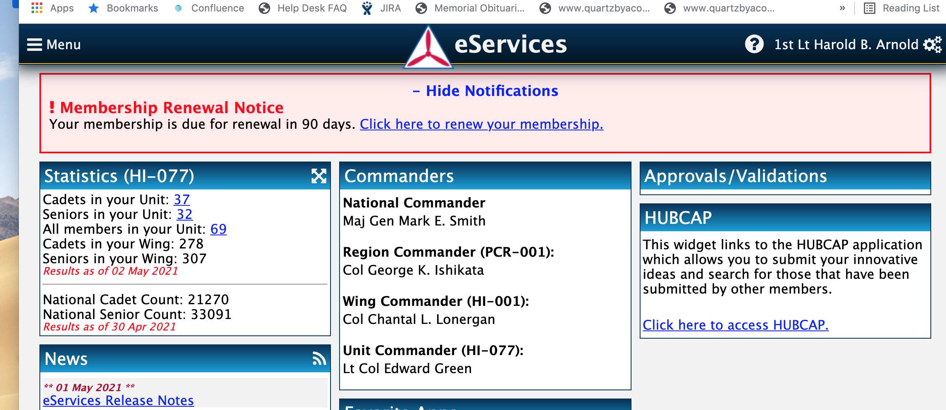
Where to Get Your CAPID Data?
Log into eServices, bringing up the home page;

Slide 5
Go to Administration, and then to Member Search

Slide 6
Use Search By User (CAPID OR NAME) below:

Slide 7
Take down the following data
Put your CAPID or your Name in the "Search by User" box
When your file comes up, note down the following:
Your rank
Your current town
Your "Original Date Joined"

Slide 8
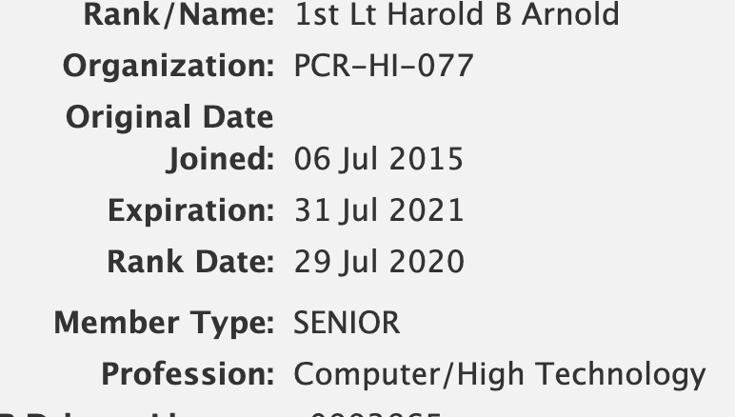

Slide 9
Open your favorite Browser, and go to this URL

Slide 10
Under the Members dropdown, select Reset Password

Slide 11
Put in the Data You Wrote Down From eServices:

Slide 12
This next page will ask you to choose an email. It will have to be an email that you know the password to, so we can send you a temporary one to logon

Slide 13
Next: continue to the next page
We will send you a temporary reset password
Using this password will require you to change to a new password so that after doing it, the original temporary password won't work, only the one you choose now will work – SO WRITE IT DOWN!
Do this now:
Go to your email that we sent your temporary password to
in your browser go to: office.com

Slide 14
This is the logon page you will always use. Notice that I went to "office.com" in the URL

Slide 15
Take very careful note of the sentence, right above the red sign in button. Note the "Sign in as ..". It has to look like this:

Slide 16
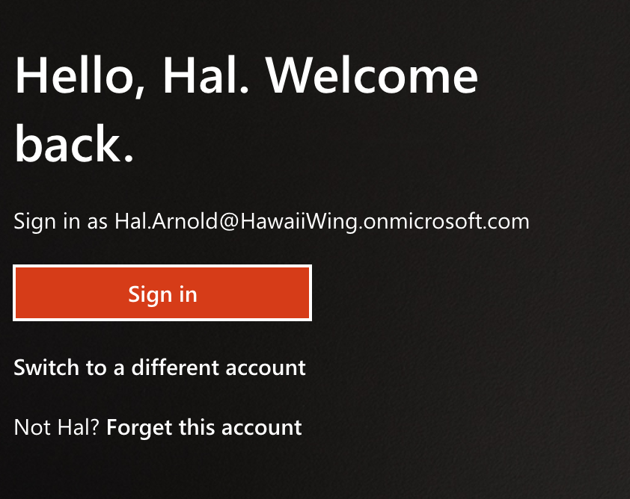
What Can Possibly Go Wrong?
If the sign in looks like this: "firstName.Lastname@hawaiiwing.onmicrosoft.com"
Do not proceed if this happens. Stop. Do not continue, do not pass Go
Call one of us!

Slide 17
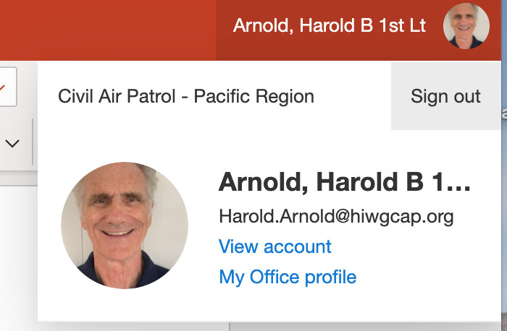
Logging Out
Find your Icon at the top right corner of the screen, next to the search box.
Click on Sign Out [It's "good hygiene" to always Sign Out]
It should look like ->

Slide 18
One last point: DO NOT USE MICROSOFT'S "FORGOT MY PASSWORD".

Slide 19
So, what do I do if I forgot my Password?
Go to the place you found this presentation, and do all the steps again from the top, right?
You can use this process as many times as you want-it will always work. Again;
NEVER USE THE MICROSOFT VERSION [see the last slide]
If in doubt, call one of the IT guys first

